Slide 1
AI applications in Finance
Lecture 1
Introduction and Overview
05-Nov-2020
Indranil Dutta

Slide 2
Course Outline
Overview of Artificial Intelligence and its use in Financial Services.
Approaches to AI and machine learning
Introduction to Neural Networks
Multilayered Feedforward Neural Networks
Case studies in Financial Services using Neural Networks
Creating a neural model for forecasting the DJIA
Creating a neural model for predicting real estate value
Creating a neural model for credit risk assessment using Neural Designer (tool)
Creating a neural model for detecting CC fraud using Neural Designer (tool)
Wrap up session

Slide 3
Agenda – Session 1
Industry outlook
Definitions
AI systems : Approaches and examples

Slide 4
Industry Outlook

Slide 5
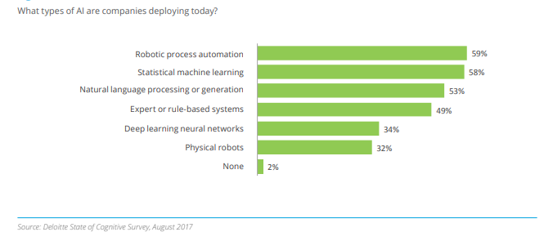
AI in industry
Source: https://www2.deloitte.com/content/dam/Deloitte/us/Documents/deloitte-analytics/us-da-2017-deloitte-state-of-cognitive-survey.pdf

Slide 6
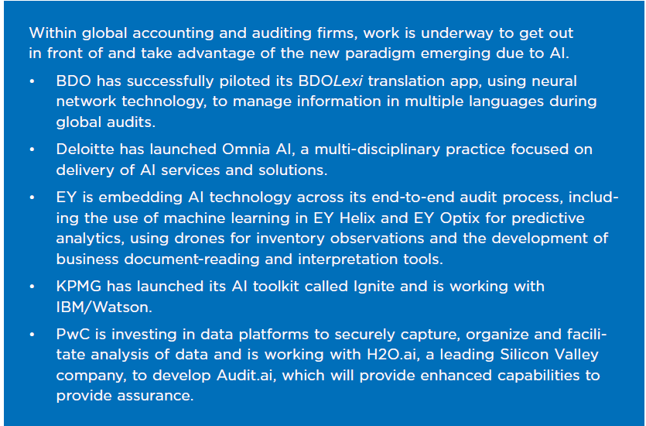
AI in Industry
Source: A CPA’s Introduction to AI: From Algorithms to Deep Learning, What You Need to Know, CPA Canada

Slide 7
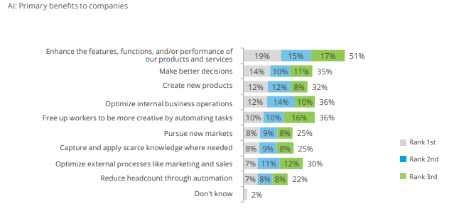
AI Benefits to industry
Source: https://www2.deloitte.com/content/dam/Deloitte/us/Documents/deloitte-analytics/us-da-2017-deloitte-state-of-cognitive-survey.pdf

Slide 8
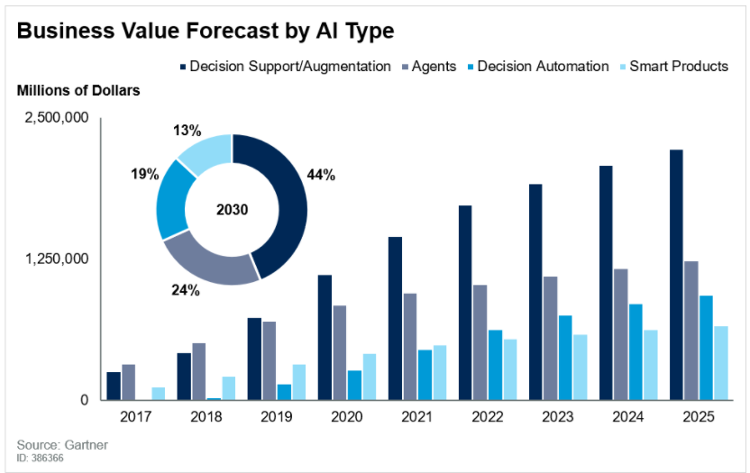
AI Benefits to industry
Source: https://www.gartner.com/en/newsroom/press-releases/2019-08-05-gartner-says-ai-augmentation-will-create-2point9-trillion-of-business-value-in-2021

Slide 9
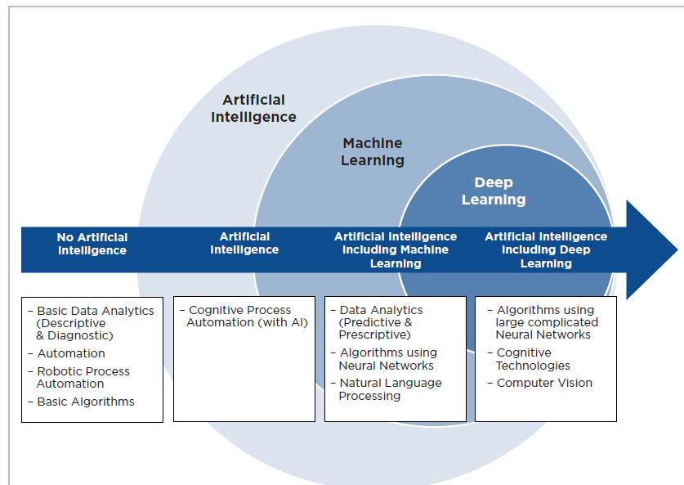
AI Continuum
Source: A CPA’s Introduction to AI: From Algorithms to Deep Learning, What You Need to Know, CPA Canada

Slide 10
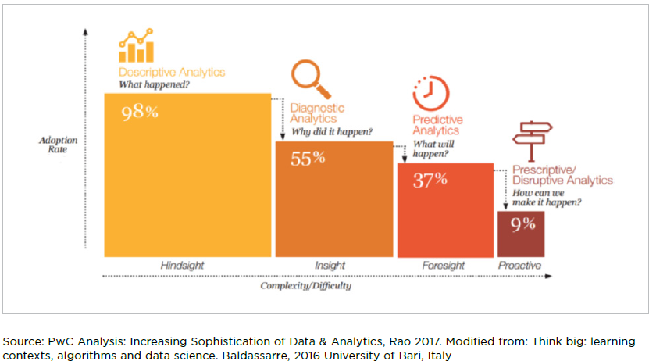
AI Continuum
Source: A CPA’s Introduction to AI: From Algorithms to Deep Learning, What You Need to Know, CPA Canada

Slide 11
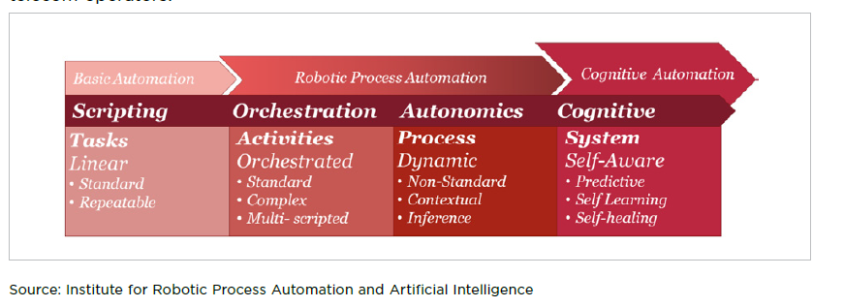
AI Continuum
Source: A CPA’s Introduction to AI: From Algorithms to Deep Learning, What You Need to Know, CPA Canada

Slide 12
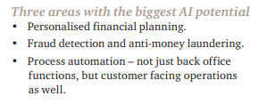
AI – Impacts on the Financial Services Sector
Benefit:
Customized, holistic & adaptive
Barriers:
Customer Trust & Regulatory Acceptance
Availability:
Now: Robo advice, RPA in finance and compliance, automated insurance underwriting
Medium term: Products based on customer sentiment and preferences
Long term: Shift from what and when things happen to proactively shape outcome (prescriptive -> predictive)
Example Use Case:
Use of Machine Learning for time series clusters of policyholder transaction.
Identified transaction patterns and helped understand variances beter
Created customer personas combing policyholder data, customer financial literacy level, customer preferences and other dimensions
Used these to predict patterns that would occur for each persona
Could design interventions around insight gained.
Better outcome for customer and company.
Source: https://www.pwc.com/gx/en/issues/analytics/assets/pwc-ai-analysis-sizing-the-prize-report.pdf

Slide 13
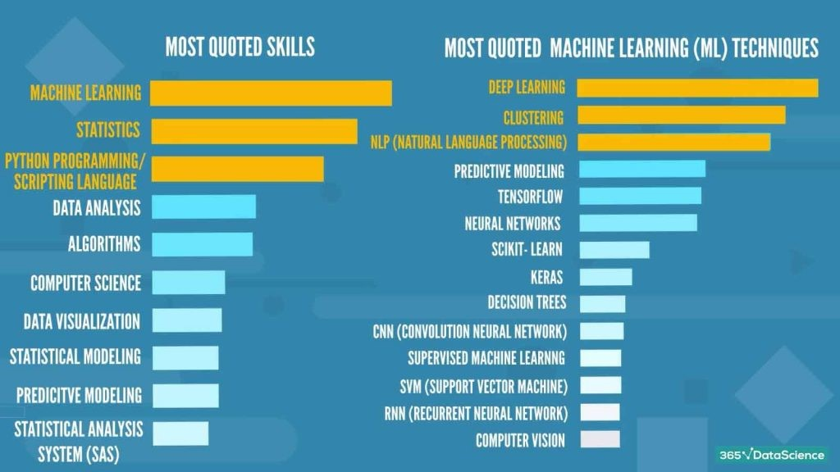
Desired Skillsets
Source: https://blogs.oracle.com/datascience/data-scientist-job-requirements-2020?source=:em:nw:mt:::RC_PDMK191126P00001:NSL400101378&elq_mid=176831&sh=181323926131815236772615330717&cmid=PDMK191126P00001C0009

Slide 14
Definitions

Slide 15
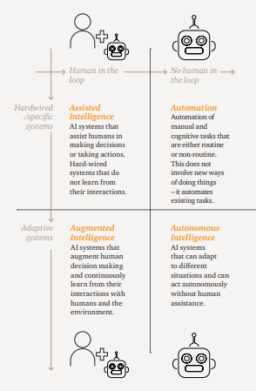
AI – System Categorization
Source: https://www.pwc.com/gx/en/issues/analytics/assets/pwc-ai-analysis-sizing-the-prize-report.pdf

Slide 16
Artificial Intelligence, Machine learning and Deep learning
Intelligence – “ability to process information to inform future decisions”
Artificial Intelligence - “ Any technique that enables computers to mimic human behaviour”
Three types – Narrow/weak (ANI) , General/Strong (AGI), Super Intelligence (ASI)
Source: MIT Introduction to Deep Learning | 6.S191 ; https://codebots.com/artificial-intelligence/the-3-types-of-ai-is-the-third-even-possible

Slide 17
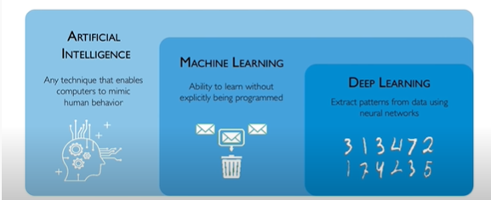
Artificial Intelligence, Machine learning and Deep learning
Source: MIT Introduction to Deep Learning | 6.S191

Slide 18
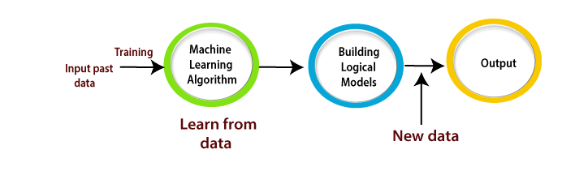
Artificial Intelligence, Machine learning and Deep learning
Machine Learning is a subset of artificial intelligence that
Learns through raw data and past experience
Is not programmed explicitly
Gives sense to new incoming data in a way similar to what a human would do.
Capacity to improve from past experience.
Source: https://www.tutorialandexample.com/machine-learning-tutorial/

Slide 19
Artificial Intelligence, Machine learning and Deep learning
Machine Learning is a subset of artificial intelligence that
Learns through raw data and past experience
Is not programmed explicitly
Gives sense to new incoming data in a way similar to what a human would do.
Capacity to improve from past experience.
Source: https://www.tutorialandexample.com/machine-learning-tutorial/

Slide 20
Artificial Intelligence, Machine learning and Deep learning
Machine Learning involves
Learning
Gaining experience
Repeats a task
Improves on performance
Source: What Is Machine Learning — [ Machine Learning | Andrew Ng , available at https://www.youtube.com/watch?v=PPLop4L2eGk&list=PLLssT5z_DsK-h9vYZkQkYNWcItqhlRJLN

Slide 21
Artificial Intelligence, Machine learning and Deep learning
Deep learning is a subset of machine learning where
Artificial neural networks (inspired from the human brain) learn from large amounts of data.
Why ‘deep’ ?
Neural Networks have various layers (implying deep/depth) to enable learning.
Deep learning algorithms perform a task repeatedly
Tweaking itself every time to improve the outcome.
Requires lots of data for training (https://web-assets.domo.com/blog/wp-content/uploads/2017/07/17_domo_data-never-sleeps-5-01.png)
When to apply deep learning?
Availability of vast data sets.
Problem at hand involves high costs
Availability of high-end computing infrastructure.
Source https://www.forbes.com/sites/bernardmarr/2018/10/01/what-is-deep-learning-ai-a-simple-guide-with-8-practical-examples/?sh=2eaf6fa28d4b
https://bernardmarr.com/default.asp?contentID=1742

Slide 22
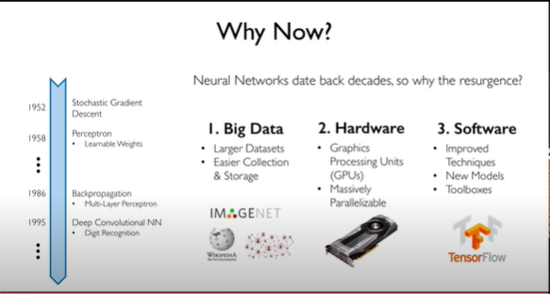
Artificial Intelligence, Machine learning and Deep learning
Source: MIT Introduction to Deep Learning | 6.S191

Slide 23
AI Systems : Approaches and Examples

Slide 24
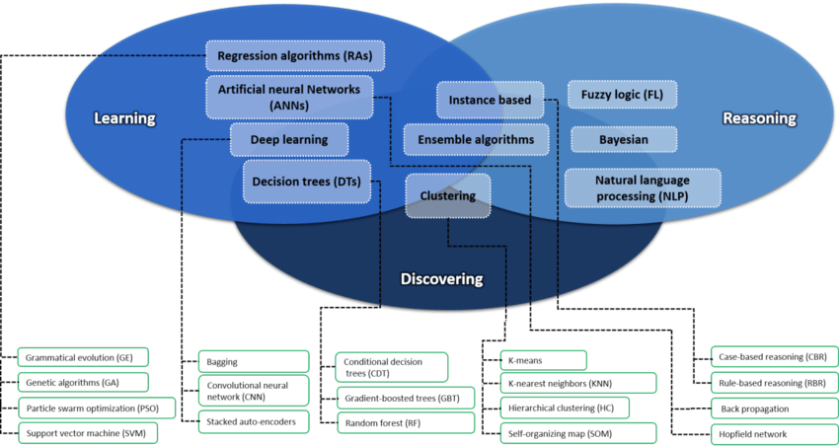
Artificial Intelligence Systems
Source: https://www.researchgate.net/figure/A-taxonomy-of-some-of-the-best-known-artificial-intelligence-methods_fig9_325162420/download

Slide 25
Approaches to AI : Case Based Reasoning
A case based reasoning system
Learns from past experience to learn new problems
Search case memory that matches the input given and provides solution.
In case of imperfect match, the new input is added as a case for future.
Reduces need to extract and structure specific rule like knowledge.
Learning and ability to make generalizations are key features.
Examples – risk monitoring, prevention of financial market manipulation etc.
Source: https://brighterion.com/artificial-intelligence-101-case-based-reasoning/

Slide 26
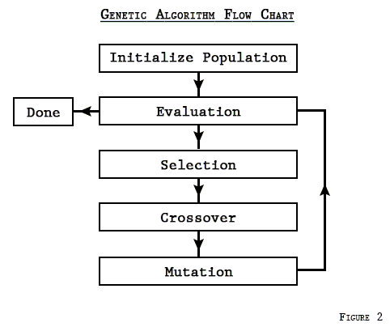
Approaches to AI : Genetic Algorithms
Genetic Algorithm based systems
Mimic process of natural evolution
Used as parameters to optimize the maximizing or minimizing some criteria.
Examples – predicting security prices by optimizing trading rules to get the best value for parameters for a given security.
Source: https://www.investopedia.com/articles/financial-theory/11/using-genetic-algorithms-forecast-financial-markets.asp#:~:text=What%20Are%20Genetic%20Algorithms%3F,-Genetic%20algorithms%20(GAs&text=In%20the%20financial%20markets%2C%20genetic,pick%20stocks%20and%20identify%20trades., https://3.bp.blogspot.com/-N_yrHnpMcjU/VNXykbeNyEI/AAAAAAAAAHk/ObHFW-C5wH0/s1600/flow.png

Slide 27
Session summary -------------------------------------------------------------
Big investments in industry (across sectors) towards machine learning
Availability of massive datasets and computing infrastructure enable machine learning.
Value addition through machine learning is the ability to ‘anticipate the future’ and tailor interventions for better outcomes.
Machine learning approaches involve
Learning through training
Validation trough testing
Predict/ provide output

Slide 28
References -------------------------------------------------------------
https://blogs.oracle.com/datascience/
https://www.pwc.com/gx/en/issues/analytics/assets/pwc-ai-analysis-sizing-the-prize-report.pdf
https://www2.deloitte.com/content/dam/Deloitte/us/Documents/deloitte-analytics/us-da-2017-deloitte-state-of-cognitive-survey.pdf
https://www.gartner.com/en/newsroom/press-releases/2019-08-05-gartner-says-ai-augmentation-will-create-2point9-trillion-of-business-value-in-2021
https://codebots.com/artificial-intelligence/the-3-types-of-ai-is-the-third-even-possible
MIT Introduction to Deep Learning | 6.S191
https://www.tutorialandexample.com/machine-learning-tutorial/
https://www.forbes.com/sites/bernardmarr/2018/10/01/what-is-deep-learning-ai-a-simple-guide-with-8-practical-examples/?sh=2eaf6fa28d4b
https://brighterion.com/artificial-intelligence-101-case-based-reasoning/
https://www.investopedia.com/articles/financial-theory/11/using-genetic-algorithms-forecast-financial-markets.asp

Slide 29
Topics for next session
Introduction to Neural Networks

Slide 30
End of Session ------------------------------------------------------------------ Questions

